Slide 1

Carbon footprint

Slide 2
Group members
SOLAR HEX
Afla.C.V
Alen.M.A
Aleena Varghese
Adhish.P.S

Slide 3
What's carbon footprint
A carbon footprint is the total greenhouse gas (GHG) emissions caused directly and indirectly by an individual, organization, event, or product.

Slide 4
Causes of carbon footprint
Burning of fossil fuels
Deforestation
Industrial process
Agriculture
Cement production

Slide 5
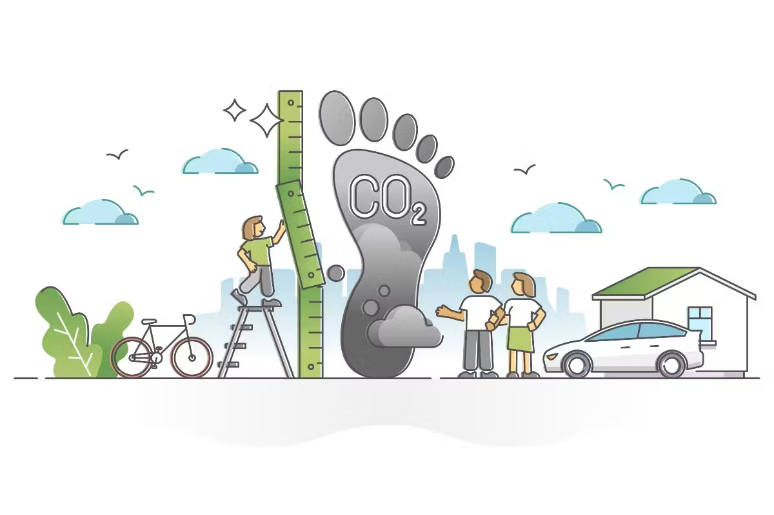
WAys to limit carbon footprint

Slide 6
WAys to limit carbon footprint
Clothing
Food
Energy and waste
Transportaion

Slide 7
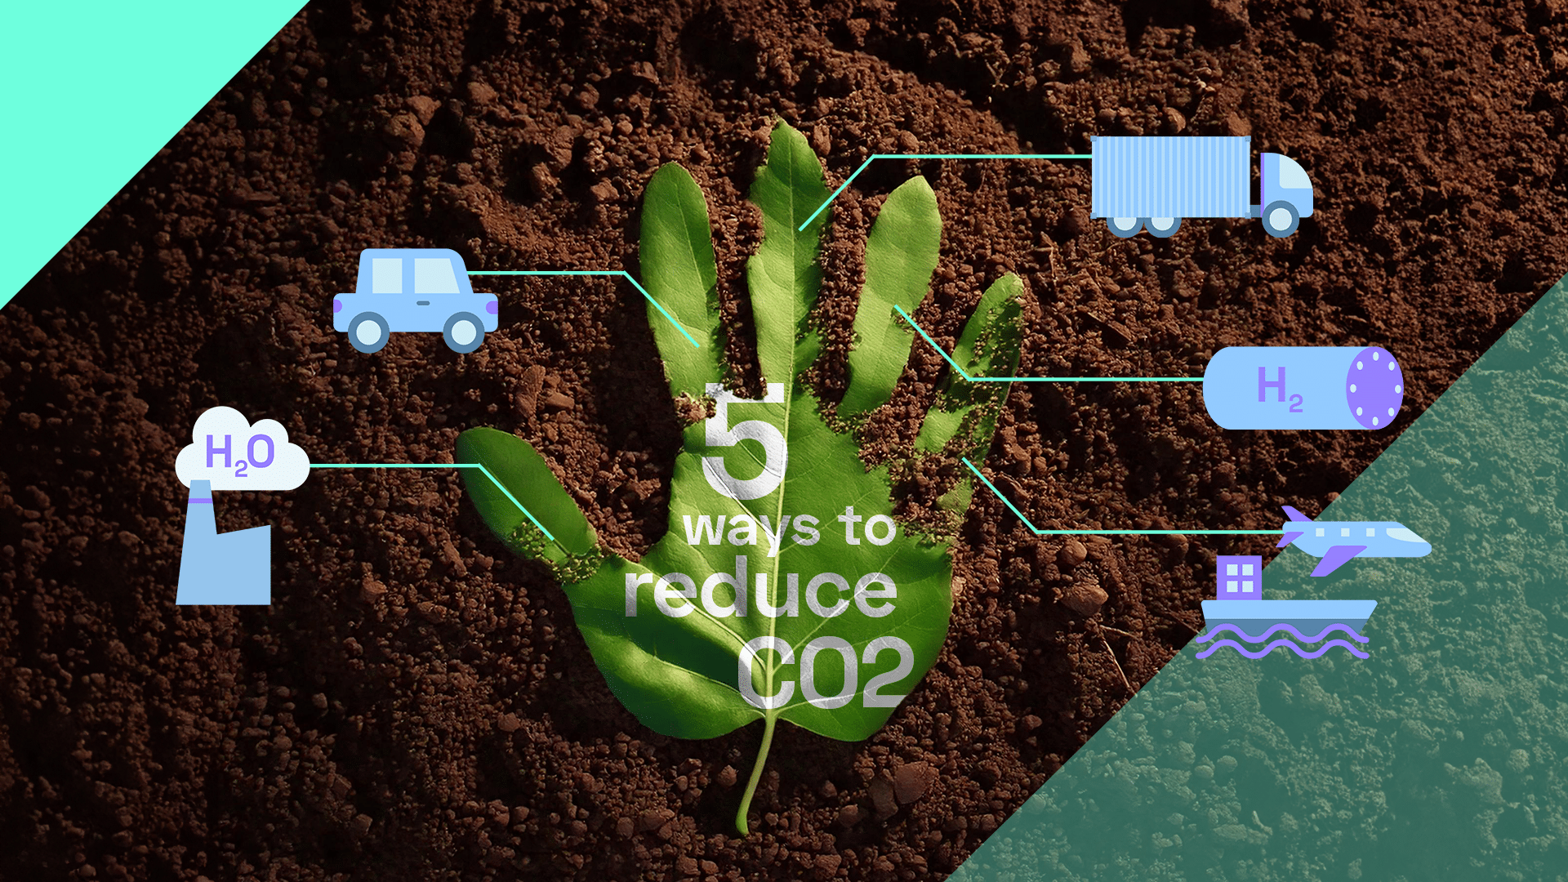

Slide 8
Measures to calculate carbon footprint
Step 1: Identify the sources of your carbon emissions
Step 2: Collect quantitative emissions data
Step 3: Convert the data and calculate your footprint
Step 4: Standardize your process

Slide 9
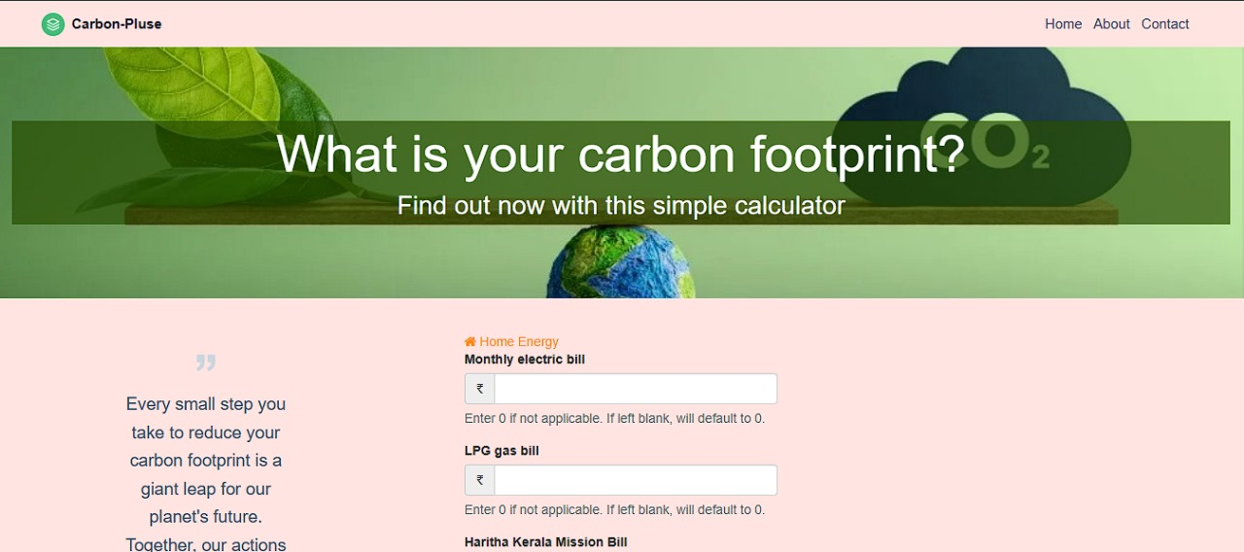
Calculation of carbon footprint using Carbon pulse
Website link :https://carbon-footprint-calculator-solarhex.netlify.app/

Slide 10
Information needed for calculation
Home energy
Travel information
Waste management
Monthly electricity bill
LPG gas bill
Haritha Kerala mission bill
Water bill
Annual miles driven
Number of flight taken
Newspaper recycling
Aluminum and Tin recycling

Slide 11

Application for footprint

Slide 12
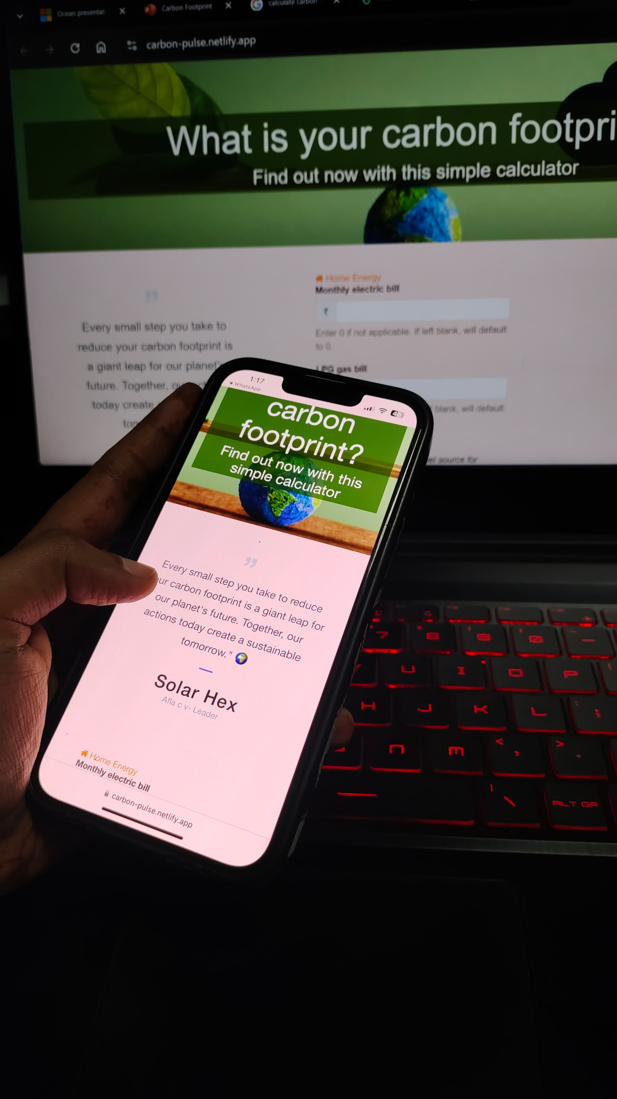


APP ICON

Slide 13
THANK YOU

